Slide 1

Arrays
01
02
Fixed-Size Sequences of Elements
03

Slide 2
Content
01
Arrays
02
Reading Arrays
03
Foreach Loop

Slide 3
01
Arrays
Working with Arrays of Elements

Slide 4
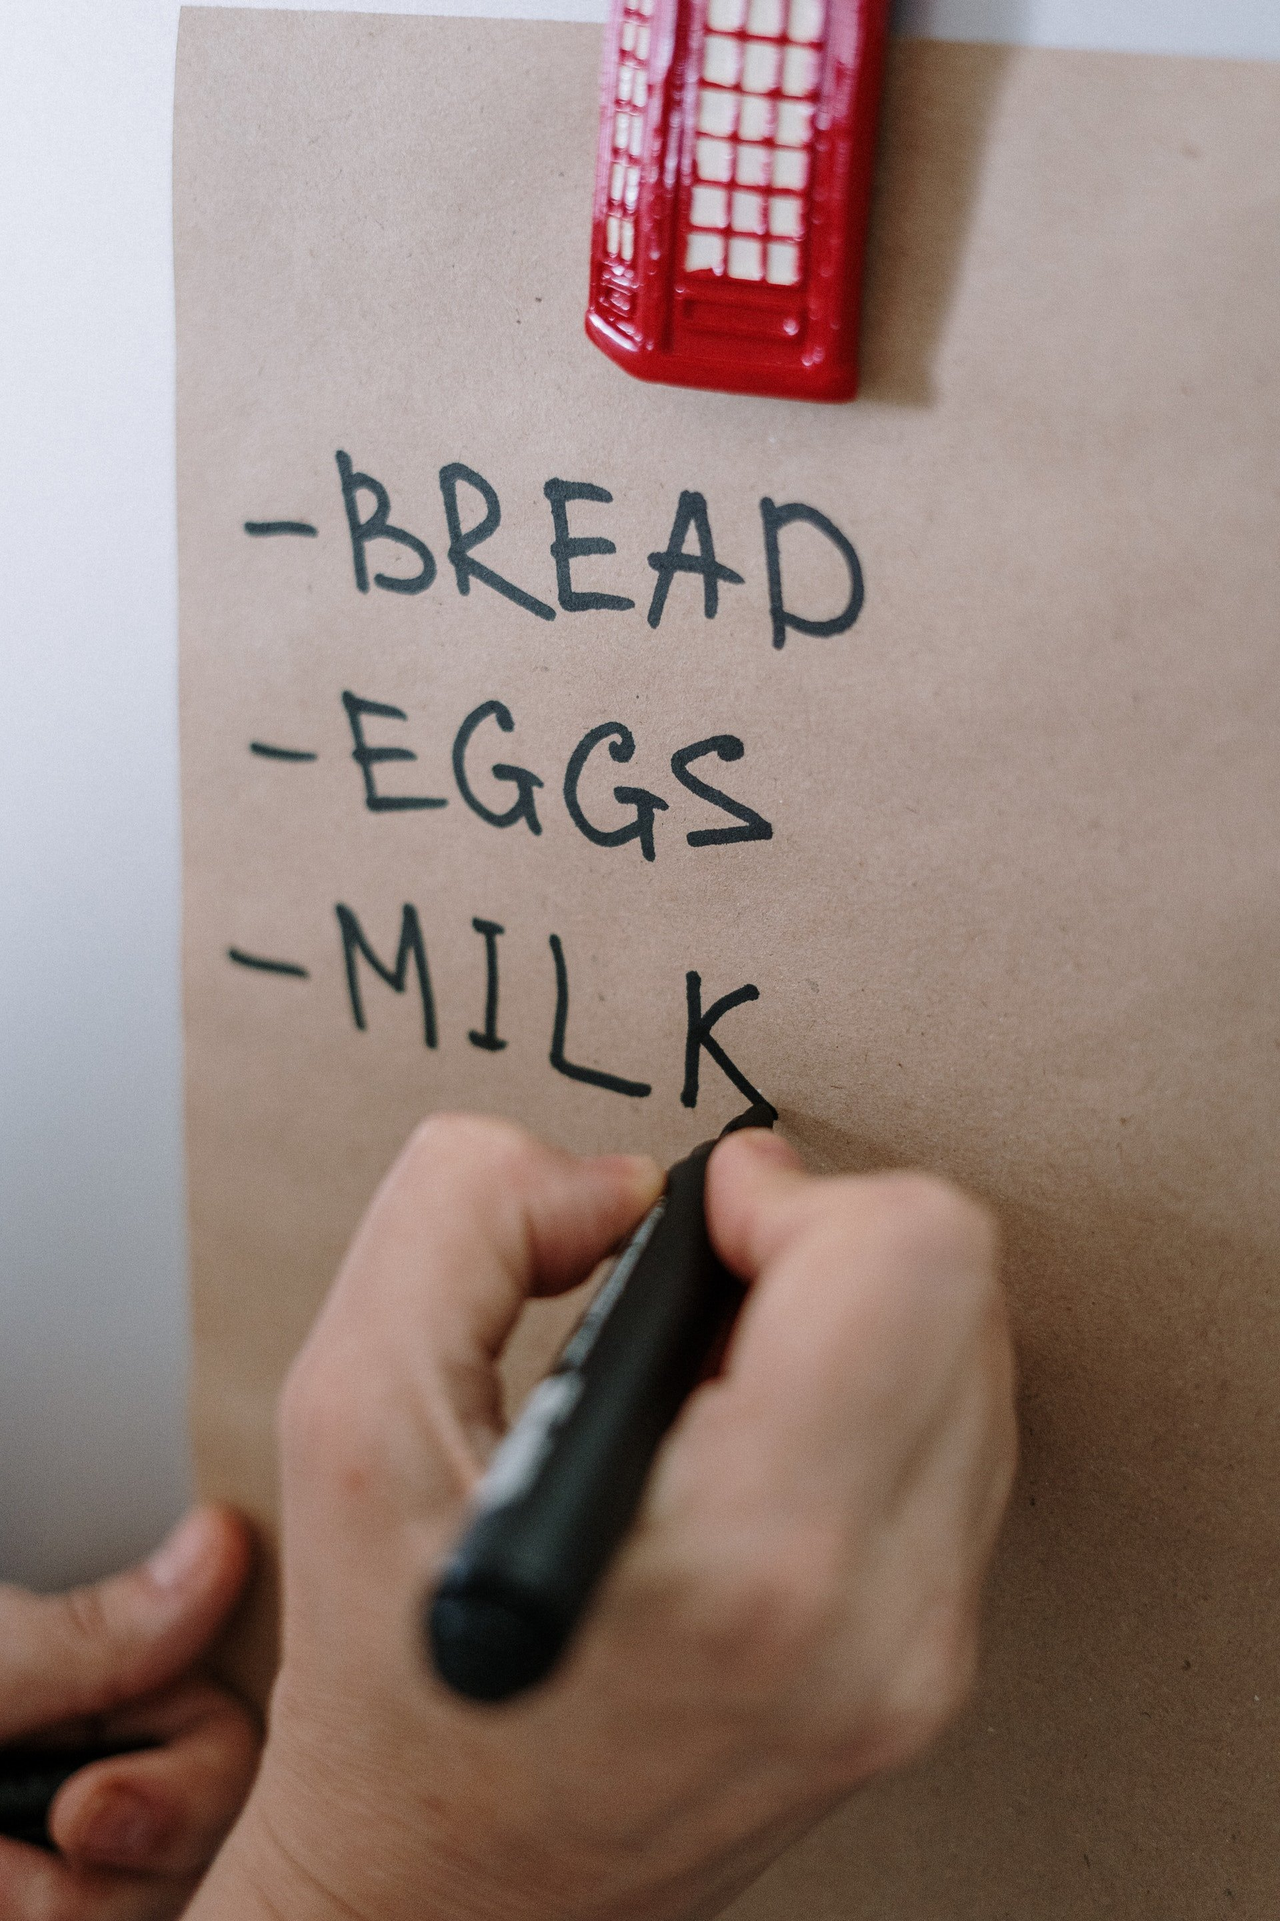
Arrays
TODO List -> collection of tasks;
Word -> collection of letters;
Sentence -> collection of words;

Slide 5
What is an array
An array is a sequence of elements
Arrays have fixed size (array.length) cannot be resized
Elements are of the same type (e.g. integers)
Elements are numbered from 0 to length-1
0
1
2
3
4
An array with 5 elements
Item index
…
…
…
…
…
Array element

Slide 6
Create an array
Allocating an array of 10 integers:
Assigning values to the array elements:
Accessing array elements by index:
int[] numbers = new int[10];
for (int i = 0; i < numbers.length; i++)
numbers[i] = 1;
numbers[5] = numbers[2] + numbers[7];
numbers[10] = 1; //IndexOutOfBoundsException

Slide 7
Day of the week
We can hold the days of the week in an array of strings
Write a function that accepts a number and prints the corresponding day of the week or " Invalid " if the number is invalid.
String [] days = {
"Monday" ,
"Tuesday" ,
"Wednesday" ,
"Thursday" ,
"Friday" ,
"Saturday" ,
"Sunday"
};

Slide 8
Day of the week
Enter a day number [1…7] and print the day name (in English) or "Invalid day!"
String[] days = { "Monday", "Tuesday", "Wednesday", "Thursday", "Friday", "Saturday", "Sunday" };
int day = Integer.parseInt(sc.nextLine());
if (day >= 1 && day <= 7)
System.out.println(days[day - 1]);
else
System.out.println("Invalid day!");

Slide 9
02
Reading Arrays
Stream API

Slide 10
Reading Arrays
First, read the array length from the console :
Next, create an array of given size n and read its elements:
int n = Integer.parseInt(sc.nextLine());
int[] arr = new int[n];
for (int i = 0; i < n; i++) {
arr[i] = Integer.parseInt(sc.nextLine());
}

Slide 11
Reading Array from a Single Line
Can be read from a single line of separated values:
1 2 3 4 5 6 7 8 9 10 12
String values = sc.nextLine();
String[] items = values.split(" ");
int[] arr = new int[items.length];
for (int i = 0; i < items.length; i++)
arr[i] = Integer.parseInt(items[i]);

Slide 12
Reading Array - Single Line
Read an array of integers using functional programming:
import java.util.Arrays;
String inputLine = sc.nextLine();
String[] items = inputLine.split(" ");
int[] arr = Arrays.stream(items)
.mapToInt(e -> Integer.parseInt(e)).toArray();
int[] arr = Arrays
.stream(sc.nextLine().split(" "))
.mapToInt(e -> Integer.parseInt(e)).toArray();

Slide 13
Printing Arrays On the Console
Print all array elements - for-loop can
Separate elements with white space or a new line
String[] arr = {"one", "two"};
for (int i = 0; i < arr.length; i++) {
System.out.printf("arr[%d] = %s%n", i, arr[i]);
}

Slide 14
Print an array
Write a function that:
It initially accepts an array of integers
Prints each element on a separate line in reverse order
4
30
20
10
0
0
10
20
30
3
1
2
3
3
2
1

Slide 15
Solution: Print Numbers Reverse
// Read the array (n lines)
int n = Integer.parseInt(sc.nextLine());
int[] arr = new int[n];
for (int i = 0; i < n; i++)
arr[i] = Integer.parseInt(sc.nextLine());
// Print the elements from last
for (int i = n - 1; i >= 0; i--)
System.out.print(arr[i] + " ");
System.out.println();

Slide 16
Round an array of numbers
Read an array of real numbers
Print each number rounded to the higher integer
0.5 -> 1
2.1 -> 3
4.3 -> 5
0.5, 2.1, 4.3
-0.5 -> 0
-2.1 -> -2
7.9 -> 8
-0.5, -2.1, 7.9

Slide 17
Exchange items
Initially receives an array of real numbers
Reverses the order of the elements and prints the array
1 2 3 4 5 6
6 5 4 3 2 1
5 6 3 2 4
4 2 3 6 5

Slide 18
03
Foreach Loop
Reading from the Console

Slide 19
Foreach Loop
Iterates through all elements
Cannot access the current index
Read-only
for (var item : collection) {
// Process the value here
}

Slide 20
Print an Array with Foreach
int[] numbers = { 1, 2, 3, 4, 5 };
for (int number : numbers) {
System.out.print(number + " ");
}

Slide 21
Even and Odd Subtraction
Read an array of integers
Sum all even and odd numbers
Find the difference
Examples:
1 2 3 4 5 6
3
2 4 6 8 10
30
3 5 7 9 11
-35
2 2 2 2 2 2
12

Slide 22
Summary
Arrays hold a sequence of elements
Elements are numbered from 0 to length – 1
Creating (allocating) an array
Accessing array elements by index
Printing array elements

